Slide 1
Representing Digital Images:
An image may be defined as a two-dimensional function, f(x, y), where x and y are spatial (plane) coordinates, and the amplitude of f at any pair of coordinates (x, y) is called the intensity or gray level of the image at that point. When x, y, and the amplitude values of f are all finite, discrete quantities, we call the image a digital image.
digital image is composed of a finite number of elements, each of which has a particular location and value. These elements are referred to as picture elements, image elements, pels, and pixels. Pixel is the term most widely used to denote the elements of a digital image.

Slide 2
M*N digital image

Slide 3
Spatial resolution
Spatial resolution can be defined as the smallest discernible detail in an image. Or in other way we can define spatial resolution as the number of independent pixels values per inch.
In short what spatial resolution refers to is that we cannot compare two different types of images to see that which one is clear or which one is not. If we have to compare the two images, to see which one is more clear or which has more spatial resolution, we have to compare two images of the same size.

Slide 4
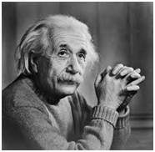
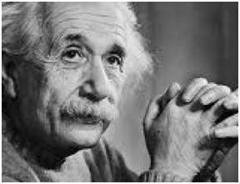
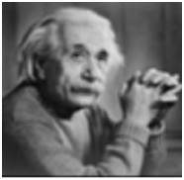

Slide 5
Measuring spatial resolution
Dots per inch: Dots per inch or DPI is usually used in monitors.
Lines per inch: Lines per inch or LPI is usually used in laser printers.
Pixel per inch: Pixel per inch or PPI is measure for different devices such as tablets , Mobile phones e.t.c.

Slide 6
Gray Level Resolution
A resolution can be defined as the total number of pixels in an image.
that clarity of an image does not depends on number of pixels, but on the spatial resolution of the image.
Gray level resolution refers to the predictable or deterministic change in the shades or levels of gray in an image.
gray level resolution is equal to the number of bits per pixel(BPP).
The number of different colors in an image is depends on the depth of color or bits per pixel.

Slide 7

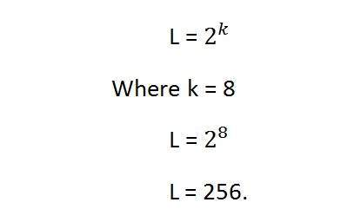
The mathematical relation that can be established between gray level resolution and bits per pixel can be given as.
In this equation L refers to number of gray levels. It can also be defined as the shades of gray. And k refers to bpp or bits per pixel.
8 bits per pixel or 8bpp.
It means it gray level resolution is 256. Or in other way we can say that this image has 256 different shades of gray.

Slide 8
Defining gray level resolution in terms of bpp
If you are given an image of 4 bpp, and you are asked to calculate its gray level resolution. There are two answers to that question.
The first answer is 16 levels.
The second answer is 4 bits.

Slide 9
Gray level resolution and quantization:
Gray level resolution is found on the y axis of the signal.
Sampling is done on x axis. And quantization is done in Y axis.
So that means digitizing the gray level resolution of an image is done in quantization.

Slide 10
Zooming Methods
Zooming simply means enlarging a picture in a sense that the details in the image became more visible and clear. Zooming an image has many wide applications ranging from zooming through a camera lens, to zoom an image on internet e.t.c.

Slide 11
You can zoom something at two different steps.
The first step includes zooming before taking an particular image. This is known as pre processing zoom. This zoom involves hardware and mechanical movement.
The second step is to zoom once an image has been captured. It is done through many different algorithms in which we manipulate pixels to zoom in the required portion.

Slide 12
Optical Zoom:
The optical zoom is achieved using the movement of the lens of your camera. An optical zoom is actually a true zoom. The result of the optical zoom is far better then that of digital zoom. In optical zoom, an image is magnified by the lens in such a way that the objects in the image appear to be closer to the camera. In optical zoom the lens is physically extend to zoom or magnify an object.

Slide 13
Digital Zoom:
Digital zoom is basically image processing within a camera. During a digital zoom, the center of the image is magnified and the edges of the picture got crop out. Due to magnified center, it looks like that the object is closer to you.
During a digital zoom, the pixels got expand , due to which the quality of the image is compromised.

Slide 14
Zooming methods:
Pixel replication or (Nearest neighbor interpolation)
Zero order hold method
Zooming K times

Slide 15
1.Pixel replication:
It is also known as Nearest neighbor interpolation. As its name suggest, in this method, we just replicate the neighboring pixels.
zooming is nothing but increase amount of sample or pixels.
if you have an image of 2 rows and 2 columns and you want to zoom it twice or 2 times using pixel replication, here how it can be done.
Row wise zooming:simple copy the rows pixels to its adjacent new cell.
Column size zooming:simply copy the column pixel to its adjacent new column or simply below it.
1 | 2
3 | 4
1 | 1 | 2 | 2
3 | 3 | 4 | 4
1 | 1 | 2 | 2
1 | 1 | 2 | 2
3 | 3 | 4 | 4
3 | 3 | 4 | 4

Slide 16
new image has a dimensions of
(Original image rows * zooming factor, Original Image cols * zooming factor)

Slide 17
2: Zero order hold
Zero order hold method is another method of zooming. It is also known as zoom twice. Because it can only zoom twice.
In zero order hold method, we pick two adjacent elements from the rows respectively and then we add them and divide the result by two, and place their result in between those two elements. We first do this row wise and then we do this column wise.
Row wise zooming
Column wise zooming
1 | 2
3 | 4
1 | 1 | 2
2 | 2 | 3
3 | 3 | 4
1 | 1 | 2
3 | 3 | 4
As we take the first two numbers : (2 + 1) = 3 and then we divide it by 2, we get 1.5 which is approximated to 1. The same method is applied in the row 2.
We take two adjacent column pixel values which are 1 and 3. We add them and got 4. 4 is then divided by 2

Slide 18
Advantages and disadvantage.
One of the advantage of this zooming technique , that it does not create as blurry picture as compare to the nearest neighbor interpolation method. But it also has a disadvantage that it can only run on the power of 2. It can be demonstrated here.

Slide 19
Method 3: K-Times zooming
It is one of the most perfect zooming algorithm discussed so far. It caters the challenges of both twice zooming and pixel replication. K in this zooming algorithm stands for zooming factor.
First of all, you have to take two adjacent pixels as you did in the zooming twice. Then you have to subtract the smaller from the greater one. We call this output (OP).
Divide the output(OP) with the zooming factor(K). Now you have to add the result to the smaller value and put the result in between those two values.
Add the value OP again to the value you just put and place it again next to the previous putted value. You have to do it till you place k-1 values in it.
Repeat the same step for all the rows and the columns , and you get a zoomed images.

Slide 20
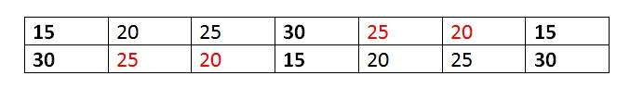
15 | 30 | 15
30 | 15 | 30
K = 3
The number of values that should be inserted is k-1 = 3-1 = 2.
Row wise zooming
Take the first two adjacent pixels. Which are 15 and 30.
Subtract 15 from 30. 30-15 = 15.
Divide 15 by k. 15/k = 15/3 = 5. We call it OP.(where op is just a name)
Add OP to lower number. 15 + OP = 15 + 5 = 20.
Add OP to 20 again. 20 + OP = 20 + 5 = 25.
We do that 2 times because we have to insert k-1 values.
Now repeat this step for the next two adjacent pixels. It is shown in the first table.
After inserting the values, you have to sort the inserted values in ascending order, so there remains a symmetry between them.
It is shown in the second table
15 | 20 | 25 | 30 | 20 | 25 | 15
30 | 20 | 25 | 15 | 20 | 25 | 30

Slide 21
Column wise zooming
The same procedure has to be performed column wise. The procedure include taking the two adjacent pixel values, and then subtracting the smaller from the bigger one. Then after that, you have to divide it by k. Store the result as OP. Add OP to smaller one, and then again add OP to the value that comes in first addition of OP. Insert the new values.
15 | 20 | 25 | 30 | 25 | 20 | 15
20 | 21 | 21 | 25 | 21 | 21 | 20
25 | 22 | 22 | 20 | 22 | 22 | 25
30 | 25 | 20 | 15 | 20 | 25 | 30
(K (number of rows minus 1) + 1) X (K (number of cols minus 1) + 1)

Slide 22
Advantages and disadvantages
The one of the clear advantage that k time zooming algorithm has that it is able to compute zoom of any factor which was the power of pixel replication algorithm , also it gives improved result (less blurry) which was the power of zero order hold method. So hence It comprises the power of the two algorithms.
The only difficulty this algorithm has that it has to be sort in the end, which is an additional step, and thus increases the cost of computation.

Slide 24
Shrinking(Down scaling, resizing downward, Down Sampling)
Image shrinking is done in the similar manner as zooming with one difference as now the process of pixel replication is row column deletion. Now we can delete every second column and row for shrinking

Slide 29
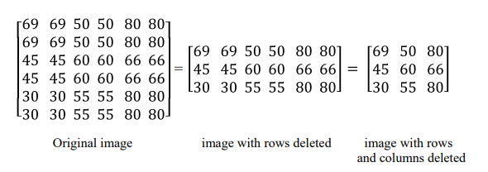

Slide 33
2D Sampling

Slide 35
Critically Sampled

Slide 36
Over Sampling

Slide 37
Under Sampling (Aliasing)

Slide 38
2D Nyquist Theoram

Slide 39
Down Sampling (Sampling Rate reduction)

Slide 41
Upsampling

Slide 43
Basic Relationships between Pixels
Neighborhood
Connectivity
Adjacency
Paths
Regions and boundaries

Slide 44
Pixels Neighbourhood
Neighbors of a pixel p at coordinates (x,y)
4-neighbors of p, denoted by N4(p): (x-1, y), (x+1, y), (x,y-1), and (x, y+1)
4 diagonal neighbors of p, denoted by ND(p): (x-1, y-1), (x+1, y+1), (x+1,y-1), and (x-1, y+1)
8 neighbors of p,denoted N8(p) N8(p) = N4(p) U ND(p)

Slide 45
Connectivity & Adjacency
Two pixels are said to be connected if they are adjacent in some sense
They are neighbors
There intensity values are the similar [gray levels are equal]
Let V be the set of intensity values
4-adjacency: Two pixels p and q with values from V are 4-adjacent if q is in the set N4(p) or Two or more pixels are said to be 4-connected if they are 4-adjacent with each others.
8-adjacency: Two or more pixels are said to be 8-connected if they are 8-adjacent with each others. Two pixels p and q with values from V are 8-adjacent if q is in the set N8(p)
8-adjacency: Two pixels p and q with values from V are m-adjacent if
(i) q is in the set N4(p), or
(ii) q is in the set ND(p) and the set N4(p) ∩ N4(p) has no pixels whose values are from V
Mixed adjacency is a modification of 8-Adjacency. It is introduced to eliminate the ambiguities that often arise when 8-Adjacency is used

Slide 46
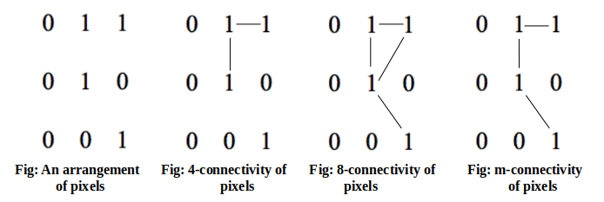

Slide 47
Let S represent a subset of pixels in an image. Two pixels p and q are said to be connected in S if there exists a path between them consisting entirely of pixels in S. For any pixel p in S, the set of pixels that are connected to it in S is called a connected component of S. If it only has one connected component, then set S is called a connected set.

Slide 48
Paths

Slide 49
Region and Boundary
Let R represent a subset of pixels in an image
We call R a region of the image if R is a connected set
We can specify the region by using 4-adjacency and 8-adjacency
Region = { Set of all pixels which fulfill adjacency criteria }
Boundary (or border)
The boundary of the region R is the set of pixels in the region that have one or more neighbors that are not in R.
If R happens to be an entire image, then its boundary is defined as the set of pixels in the first and last rows and columns of the image.
Foreground and background
An image contains K disjoint regions, Rk, k = 1, 2, …, K. Let Ru denote the union of all the K regions, and let (Ru)^c denote its complement
All the points in Ru is called foreground;
All the points in (Ru)^c is called background.

Slide 50
Connected Component Labeling
Ability to assign different labels to various disjoint connected components of an image
Connected component labeling is a fundamental step in automated image analysis (Shape, Area, Boundary)

Slide 51
Distance measures
Euclidean distance
City-block distance or D4 distance.
D8 distance or chessboard distance.

Slide 52
Euclidean distance
The Euclidean distance between p and q is defined as
De (p, q) = [(x - s) ^ 2 + (y - t) ^ 2] ^ (1/2)
City-block distance or D4 distance
The distance between p and q is defined as
D4(p, q)= | x - s | + | y - t |
D8 distance or chessboard distance.
D8(p, q)= max (| x - s |, | y - t |)

